Slide 1
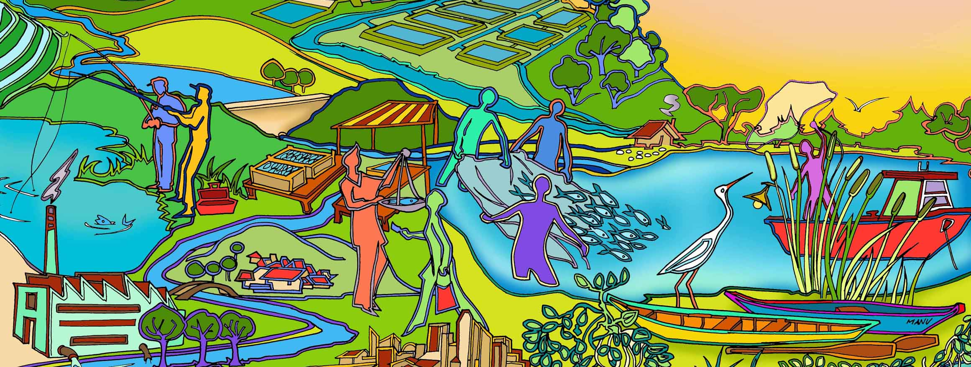
Session 10
Step 1: Define and scope the Fishery Management Unit (FMU)
Essential EAFm training
Date | Place

Slide 2
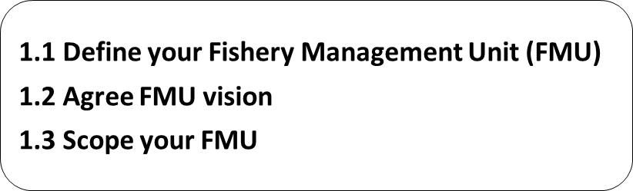

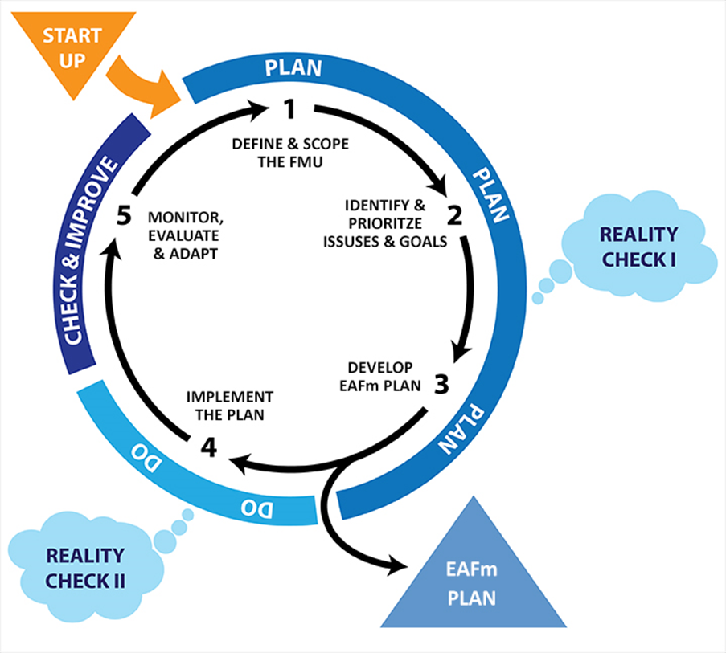
Notes:
We are now about to start Step 1.
There are 3 sub-steps (i) define the FMU, (ii) Agree on a FMU vision and (iii) Scope the FMU.
Refer to large visual of this on wall (keep up as reference throughout course).

Slide 3
Session objectives
After this session you will be able to:
Describe FMU defining and scoping
Undertake visioning and be able to agree on a vision
Notes:
Self explanatory

Slide 4
Remember
The start up tasks (Startup A & B) prepared us for the 5 EAFm steps:
Initiate stakeholder engagement
Facilitate co-management
Engage stakeholders
Note that this dialogue was initiated in the start up but it continues throughout the whole process
Notes:
Remind participants of where we left off yesterday/ day 2 (learning different approaches to engagement stakeholders (how to be a good facilitator, methods to elicit stakeholder input, focus group discussions, interviews). In the Startup tasks, stakeholder engagement and co-management principles are initiated but this continues and is maintained through the whole cycle of 5 steps. The first one being....

Slide 5
1.1 Define your FMU
Define your Fishery Management Unit (FMU)
i.e. the fishery and area you will manage.
The FMU should be:
  Multi-species
  Multi-gear, if catching the same species
  Multi-gear, if conflicts between them occur
  Multi-jurisdictional, if different jurisdictions involved
Notes:
In step 1.1 stakeholders will need to decide what it is they are going to manage i.e. the Fisheries Management Unit (FMU). From the startup tasks they will already have a rough idea but this needs to be revisited under the principle of the appropriate scale (#2).

Slide 6
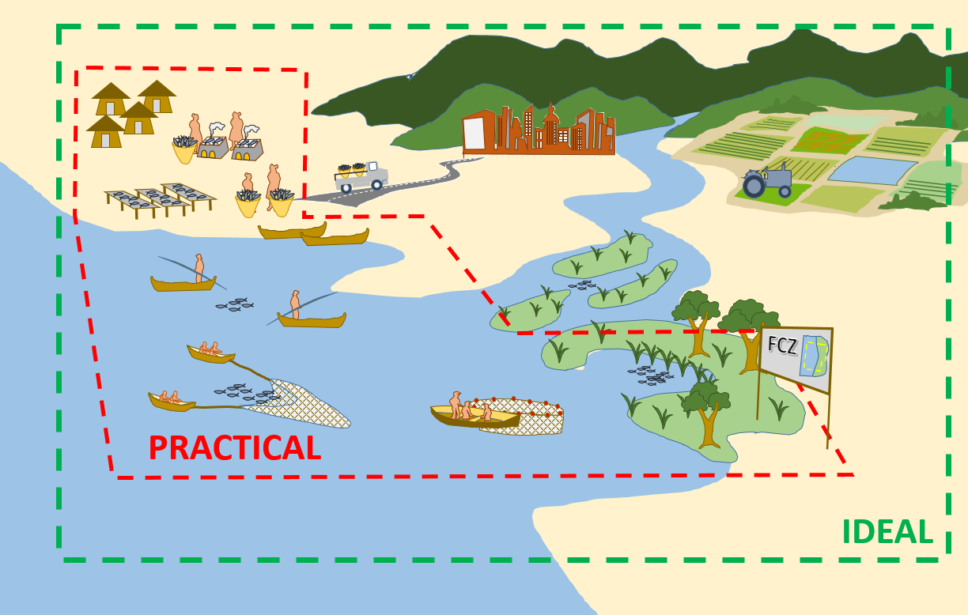
FMU: ideal versus practical reality
Notes:
Ideally, FMU should be the whole diagram (GREEN BOX):
Relate to some known ecological boundaries
Cover the whole of the geographical range of the main stocks
Cover all the gears that are fishing that stock,
In reality, however, this is often not possible and some important parts of the ecosystem will fall outside of the FMU (RED BOX). It is likely some gears and part of stock range will be excluded too.
See Participant Handbook Module 10, Figure 10.1.

Slide 7
Reality – dealing with what is not included
Must recognize that FMU may not completely cover whole area and consider this in the planning
Engage “outsiders” in planning process, especially:
  a fishery/stock shared by two districts/provinces/countries
  both small-scale & large-scale fishers operate on the same fishery/stock
  Other water-users
Look for more appropriate scales later on in the process (e.g. joint management over several districts).
Notes:
Try to include as many “outsiders” as possible, especially when the stocks are shared or when different gears are used to fish the same stock.

Slide 8
Activity: In your groups
Create a map of your FMU area, including:
Ecological boundaries
  Barriers, flooding/dry-out areas, water inflows, sources of pollution
Habitat areas
  breeding grounds, spawning areas, conservation sites, deep pools/refuges
Social boundaries
  e.g. communities, landing sites, taboo areas, conflict points, etc.
Political jurisdictional boundaries
  including national/province/district jurisdictions
Notes:
See Session Plan for details.
Participants work in their groups to define their FMU (define its boundaries) and draw a map of this on 1-2 sheets of flipchart. Use internet/ other real maps from participants and organisers as support.
For trainer info : this map provides background support (and can be added to) over next few days; they will also use it later today when discussing stakeholder conflicts, and it should be part of their presentations.
Groups will easily plot ecological/fisheries aspects. Trainer to ask questions to prompt for human and governance elements as these are harder to map (e.g. where are the ports/ landing sites? where is fishery officer located? Which are traditional/ customary use areas?...)

Slide 9
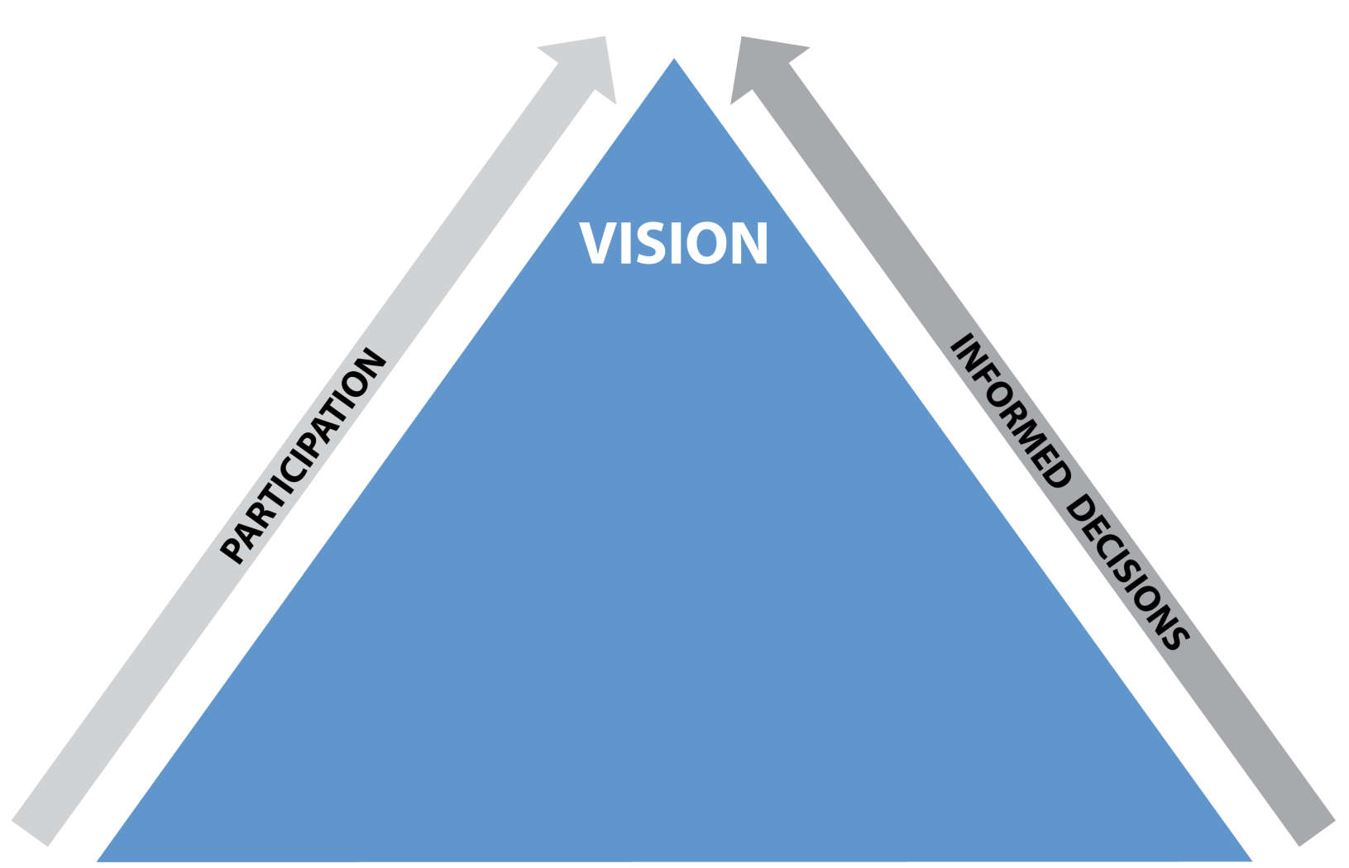
Building the EAFm plan
Notes:
In STARTUP A and B, and in this Step 1, we highlight the need for participation - right throughout the cycle (ARROW on left-hand side) - and the need for data and information with informed decisions (ARROW on right-hand side).
The first step of building an EAFm plan is to develop an agreed VISION with stakeholders.

Slide 10
Vision, goals and objectives
Vision: long-term aspiration (20-30 years) of what you would like the FMU to be like (as a dream)
Goal: Shorter-term view (5-10 years) of what you are aiming for in terms of a set of issues (theme)
Objective: What you are trying to achieve in terms of a specific issue
Notes:
In planning processes we often talk about “Vision”, “Goal” and “Objective”. All these refer to what we are trying to achieve but differ in (i) scope - a vision is broad, while an objective is narrow and in (ii) time – a vision often refers to 20-30 years, while an objective can be set for a shorter time period.

Slide 11
The Hierarchy (levels)
Vision
Aspiration for the future
1 Vision
Goals
Goals for different set of issues
3-4 Goals under the 1 vision
Objectives
Objective for each priority issue
a number of objectives
under each goal
Notes:
Vision, goals and objectives are part of a hierarchy and are linked.
We have one vision, several goals under that vision (one for each theme) and a number of objectives for each goal (one for each issue).
See Participant Handbook Module 10, Figure 10.2.

Slide 12
1.2 Agree on FMU vision
What should FMU look like in 20-30 years (outcome of management)?
May include:
  Increased benefits to stakeholders
  Sustainable use of the resources
  Increased ecosystem services
Activity:
Agree on broad management vision for your FMU
Notes:
A vision should describe what the FMU should look like in 20-30 years time.
Groups have 10 minutes to agree their FMU vision. Give the option of drawing a vision as well- but they do need a written version.
Refer to Technical Toolkit, Tool n. 23 for more on Visioning.

Slide 13
1.3 Scope the FMU: collate background information
You have defined the FMU and have a vision.
Now, the FMU needs to be scoped for relevant and useable information to serve as:
Basis for planning and management activities
(as included in the EAFm plan)
Baseline for future monitoring and evaluation (M&E)
Notes:
Scoping the FMU is simply bringing together all the relevant background information to the EAFm plan so that it can inform the planning process and also act as a baseline for future monitoring & evaluation (M&E).

Slide 14

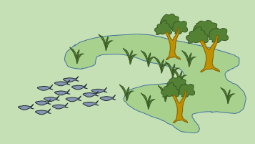

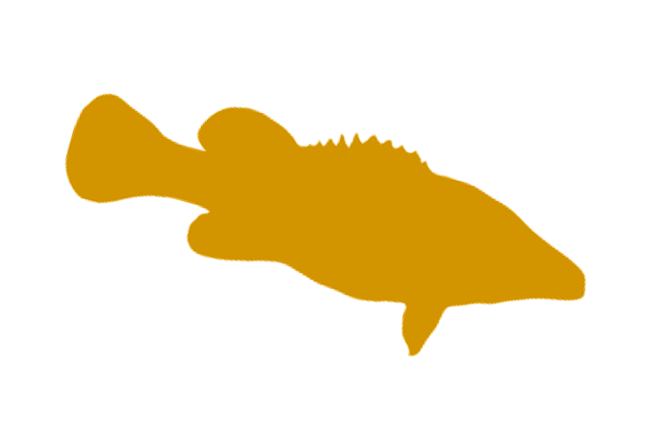

Scoping includes
Communication
for planning and
decision-making
Information
(Data collation/analysis)
Data collection
(Both new and existing)
Notes:
This shows the flow from data to informed decision making through 2 steps (i) from data collection through to data collation and analyses that produces information and (ii) from information through to informed decision making using effective communication of findings.

Slide 15
Types of data
Qualitative data (informal) | Quantitative data (formal)
Analyze “how and why” e.g. structured and semi-structured interviews (includes focus group) surveys using open-ended questions participatory methods observation | Numerically measure “who, what, when, where, how much, how many, how often” e.g. standardized interviews biophysical surveys surveys using closed questions
Notes:
Participants need to understand basic difference between qualitative and quantitative data, and that each provides answers to different questions. In fact a good data/ M&E system should have both types of data as they complement each other.
NB. Quantitative data does not necessarily mean needing complex IT systems; basic Excel package in Microsoft can suffice.

Slide 16
Information needed for the three components
Ecological (including the fish)
Human (including socio-economic)
Governance (including legal and institutional)
Notes:
Because EAFM has three components (see chart in Visual Gallery on the wall), it has three components of information (i) ecological, (ii) socio-economic and (iii) governance
More detail as background
3 types of info can be gathered through 3 types of assessments explained in Technical Toolkit. Data can be Qualitative and quantitative and “research” covers scientific and participatory research, including using indigenous knowledge to help answer questions.
Even the apparently simple question “Is the stock overfished or under fished?" seems almost impossible to answer without (scientific) fishery stock assessment data. However, this should not be the obstacle to starting to take action. Indeed, there are plenty of indicators which can be used that provide a good idea of the status of stock or fishery and these can be gathered through checking the catches of fisheries, looking at landings, and using traditional or local knowledge of fishers regarding historic trends.

Slide 17
















Information
Climate change, rainfall
Deforestation
Mining wastes
Upper watershed soil erosion
Recreational fisheries
Reservoir & lake fisheries
River training , flood proofing of cities & industry
Industrial pollution
Irrigation & hydropower impacts
Irrigation
Cities & towns sewage & solid waste
Agricultural impacts
Aquaculture effluents, escapes
Fish traders & markets
Small-scale fisheries
River & floodplains
Fish refuges & protected areas
Wetland drainage and degradation
Saltwater barrage
Notes:
This is same slide introduced in session 2 (slide 10) and in Visual Gallery.
Fisheries management needs to consider more than people in boats, fish in the water. It needs to move from considering just fisheries to considering the main components in the ecosystem and their interactions.
What are the main elements of this ecosystem that you will need data & information on?
Get participants to identify the elements:
Data and information will be needed on at least:
Fish
Fishing gear, fishers,
Processers and buyers
Other users (e.g. aquaculture, scuba divers)
Habitats
Fishing communities
Governments
STRESS that data & information are needed from different government departments (fisheries, environment, labour, health?...) as well as from research institutions, universities, NGOs... And data is needed on different aspects of the ecosystem.

Slide 18
Existing and new information
Large amount of data and information already collected; need to know where to find it:
  Fishery statistics
    catch, effort, stock assessment, economics
  Research results
    biological/ecological, habitat, environment
  Socio-economic data
    who and how people use the resource and how they benefit
  Annual reports
    what the current governance arrangements are
May have to collect some new data
Notes:
Data and information can be gathered from various sources and it is important to realise that in many cases, this information is held, or can be provided by a variety of bodies, organizations or groups.
Get participants to brainstorm where these different types of data may come from.
More detailed background
The important consideration is judging whether all the issues are covered. An EAFm plan that focuses on the target species and does not consider the effects on non-target species or habitat impacts that threaten sustainability will not be very effective. Equally, addressing only fishery issues (e.g. resources, gears, stocks), whilst not taking into account social or economic issues relating to the fishers will run into problems, as compliance with the plan is likely to be compromised.

Slide 19
After scoping...
Share and check the findings with stakeholders
Stakeholders can provide valuable information that you have missed
Remember this is not final and should be reviewed and added to periodically as more information is generated
Notes:
It is important to share the scoping information with stakeholders. Data collection and research is not the only activity. Need to analyse, discuss, feedback and re-draft report. Point out that findings need to be typed up as report (for literate audience- see template on last page of Module 10). Need to think about visuals. Also consider other forms of reporting for non literate stakeholders to ensure they retain ownership.
Refer participants back to the EAFm template so that they can see that they are making progress.
This links to step 5, as part of reviews, the idea is to add to the background so that you can build your knowledge base of FMU.

Slide 20
Sharing with stakeholders
Share information on the FMU and stakeholders based on the start up work: map and Venn diagram
Share findings on fishery background
Share vision
Seek agreement on the FMU and the major stakeholders
Discuss the background information, asking stakeholders to identify mistakes and gaps
Discuss the broad vision
and adjust if necessary
Notes:
Validation step is important to foster ownership and motivation. If there is major disagreement on vision or other elements these need to be addressed and ironed out, before you can move onto step 2.
We do not do these steps in this course- but this is what would be done after scoping.

Slide 21
Now finished Step 1.
We can start writing an EAFm plan
EAFm Management Plan for FMU X
Vision (Step 1)
Background (Step 1)
  Possible subheadings:
  The fisheries management unit
  History of fishing and management
  Current status of the fishery
  Existing management arrangements
  Socio-economic benefits
  Special environmental considerations
  Institutional aspects
Notes:
Refer to the EAFm template on visuals gallery on wall.
The results of Step 1 can be used to write Sections 1 & 2 of the EAFm Plan – VISION and BACKGROUND.
Suggested headings for the background include the history of fishing, current status and existing management arrangements, socio-economic benefits and institutional aspects, such as Fishery Laws, etc.
Tell participants that they will be developing one of these during the course. EAFm plan as an output and guiding tool.

Slide 22
Key messages
In Step 1:
The fishery and boundaries of the unit to be managed are agreed (FMU)
A common vision for the FMU is developed with stakeholders
Background information on the FMU is collated and shared
Notes:
Self Explanatory

Slide 23
In your groups
Identify:
Types of information you would collect for scoping
  Tip: Look at the different headings of the EAFm plan background section
What methods might you use?
What sources of information would you use?
Record your outputs on a flipchart
23
Notes:
Must have all information recorded by all groups on Flipchart. Groups should also then record in their own Workbooks.
Groups need to identify what types of information they would collect to cover all 3 EAFm components, what collection methods they would use and where they would access this information. Participants will tend to focus on ecological information, so trainers must ensure they think also of the other 2 components.
The purpose of this activity is to highlight the need for other types of information that are beyond existing management, to get participants to think about synergies, cooperation between agencies, beyond the traditional fisheries stakeholders.

